Slide 1

BANK LOAN
ANALYTICS
Team Members (Group-6):
Kunal Rajbhar
Harmeek Singh
Gauri Jiddewar
Gaurav Gadekar
Ambar Sharma
Vandit Rajamani
Mentor Name:
Srinivas Jeeyar G
Suraj Kumar

Slide 2
TABLE OF CONTENTS
01
INTRODUCTION
DATSETS
PROJECT PROCESS
TOOLS USED FOR ANALYSIS
KPI’S
DASHBOARD IMAGES (EXCEL, TABLEAU, POWER BI)
INSIGHTS
RECOMMENDATIONS
CONCLUSION
02
03
04
05
06
07
08
09

Slide 3

The Bank Loan Analytics Dashboard provides a comprehensive view of the bank's loan portfolio, borrower demographics, and credit performance. By leveraging historical data, this dashboard helps in understanding loan disbursement trends, repayment behaviors, and risk factors associated with different borrower profiles.
Key Goals:
Track and monitor loan performance
Evaluate borrower risk profiles
Improve risk assessment

Slide 4
DATASETS
Finance1.xlsx
Contains detailed loan-level data, including loan amounts, interest rates, and borrower information such as loan grades and verification status
01
02
Finance2.xlsx
Provides insights into borrower credit behavior, including variables like revolving balance, annual income, and home ownership status.

Slide 5




01
Data Extraction
02
Data Transformation
The data was sourced from two CSV files containing detailed bank loan and borrower information.
Clean and prepare data.
Handle missing values, remove duplicates, correct errors.
Standardize data formats.
PROJECT
PROCESS
03
Data Analysis
04
Dashboard
Various statistical methods and visualizations were employed to understand the data distribution and identify trends.
An interactive dashboard was created to present findings and key insights.
Design layout for clarity and impact.

Slide 6




Tools Used For Analysis
EXCEL
MySQL
Tableau
PowerBI

Slide 7
KEY PERFORMANCE
METRICS

Slide 8
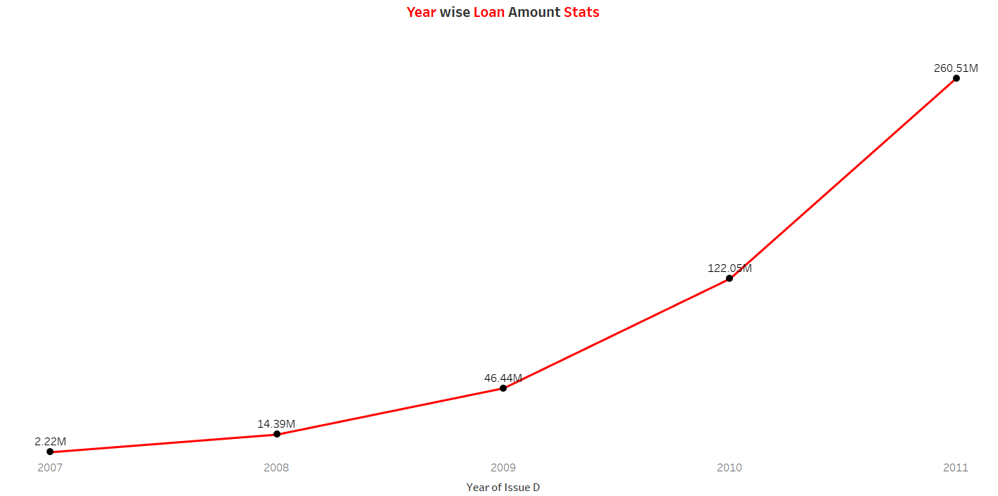
KPI 1: Year wise Loan Amount Stats
In 2011, we see the highest loan disbursement at $260.51M.
A significant increase from $46.44M in 2010 and $14.39M in 2009.
The trend showcases rapid growth in loan volume, peaking in 2011, with slower activity prior to that.

Slide 9
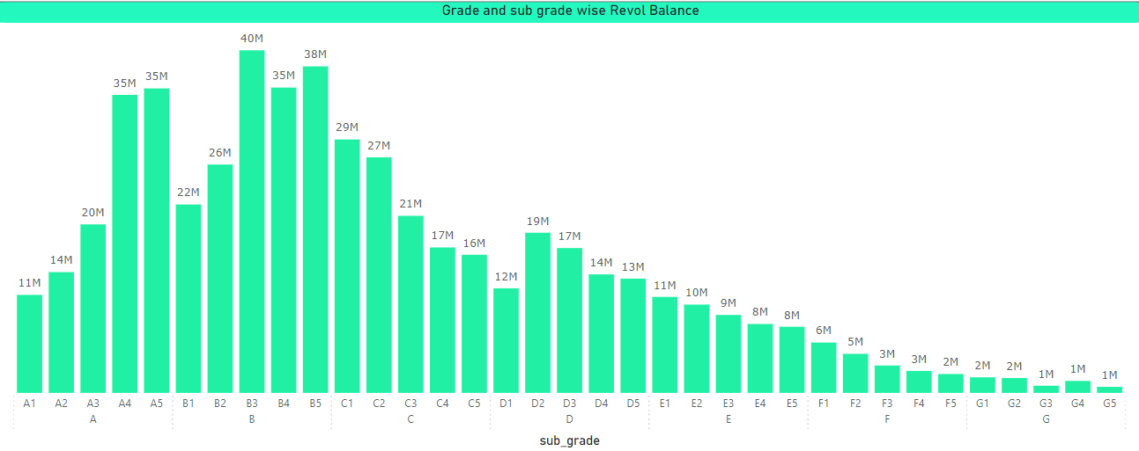
KPI 2: Grade and Sub-grade wise Revolving Balance
The highest Revolving Balance occurs in B4 and B5 sub-grades, each contributing around $35M.
Grades A and B show higher balances, while Grades D and E have lower balances.
The lowest is in sub-grade E5 at $9M.

Slide 10
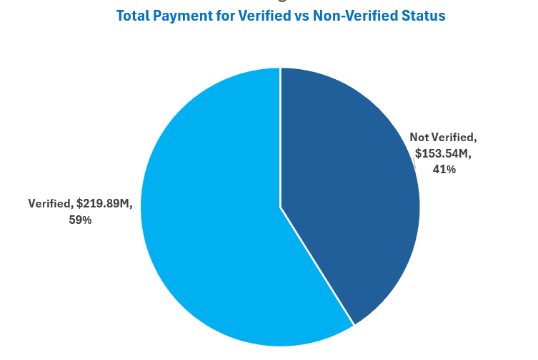
KPI 3: Total Payment for Verified Status Vs Total Payment for Non Verified Status
Verified Borrowers contribute 58.88% of the total payment, amounting to $219.89M.
Non-Verified Borrowers make up 41.12%, contributing $153.54M.
Verified borrowers account for a higher percentage of total repayments, indicating stronger creditworthiness.

Slide 11
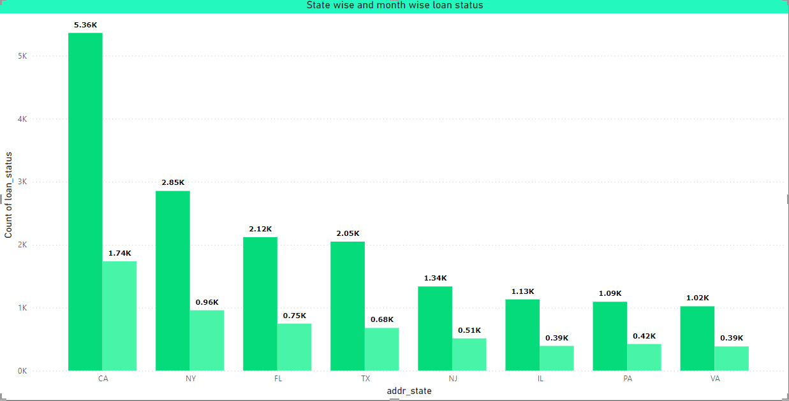
KPI 4: State wise and Month wise Loan Status
California (CA) has the highest loan count with 5.36K loans, followed by New York (NY) at 2.85K loans.
Other states such as Florida (FL) and Texas (TX) show moderate loan counts, while Virginia (VA) and Pennsylvania (PA) have lower counts.
The state-wise breakdown helps us identify high-volume regions, while the month-wise data can be used to track seasonal trends in borrowing.

Slide 12
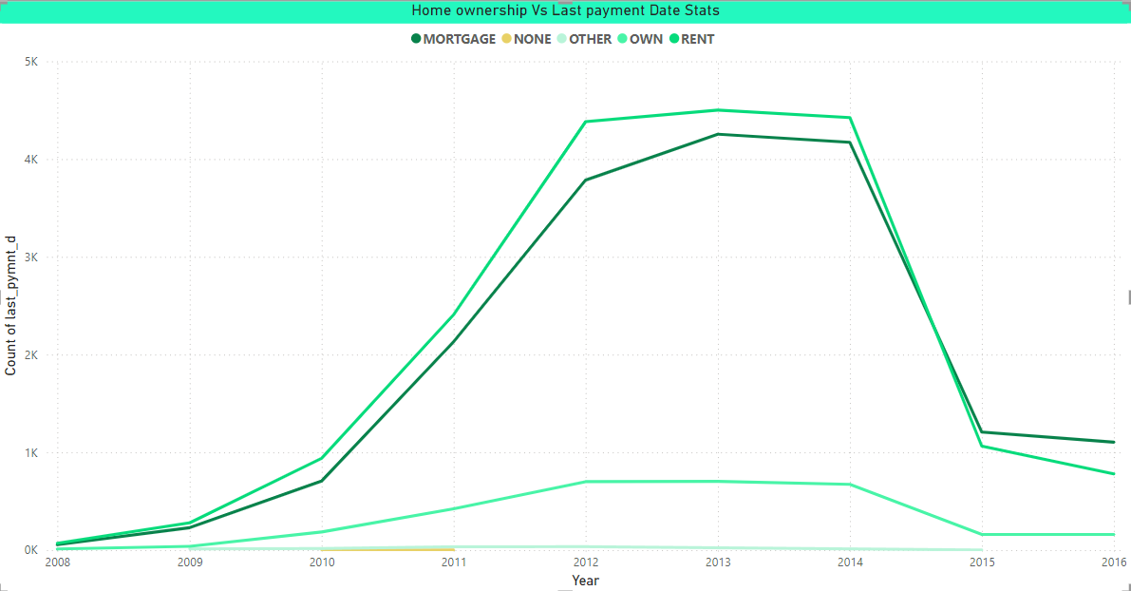
KPI 5: Home Ownership Vs Last Payment Date Stats
Mortgage holders show the highest repayment amounts over time, peaking around 2014, and then experiencing a decline.
Renters and those with no home ownership (NONE) show much lower payment volumes.
The high repayment from mortgage holders suggests that those with more secure home ownership statuses are more reliable in repaying loans.

Slide 13
DASHBOARD IMAGES

Slide 14
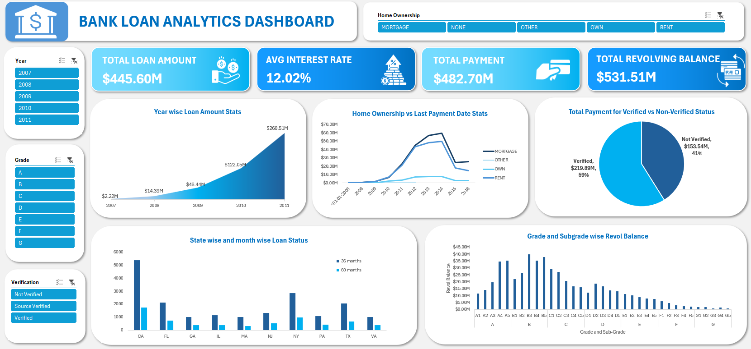
EXCEL DASHBOARD

Slide 15
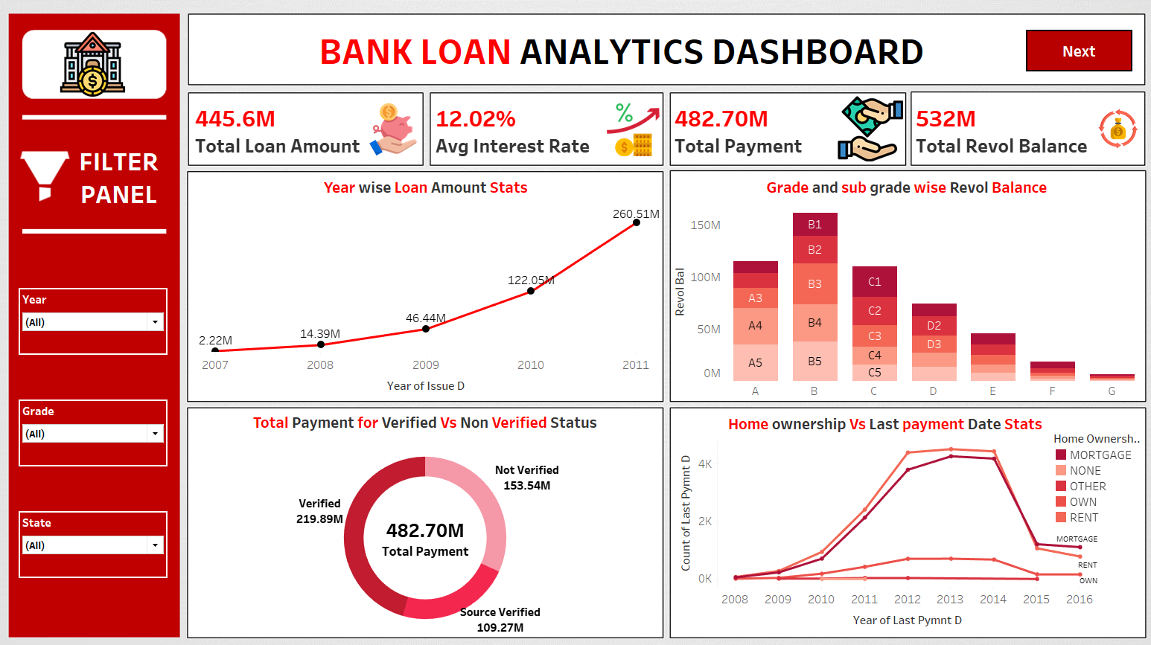
TABLEAU DASHBOARD PAGE-1

Slide 16
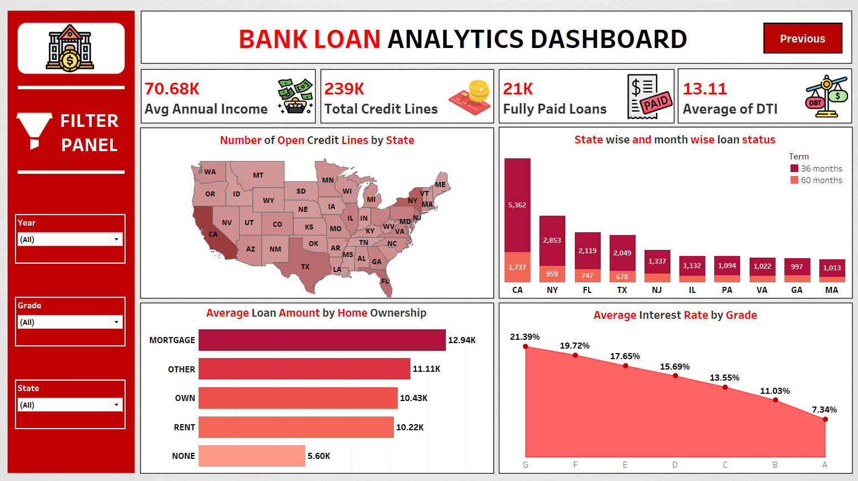
TABLEAU DASHBOARD PAGE-2

Slide 17
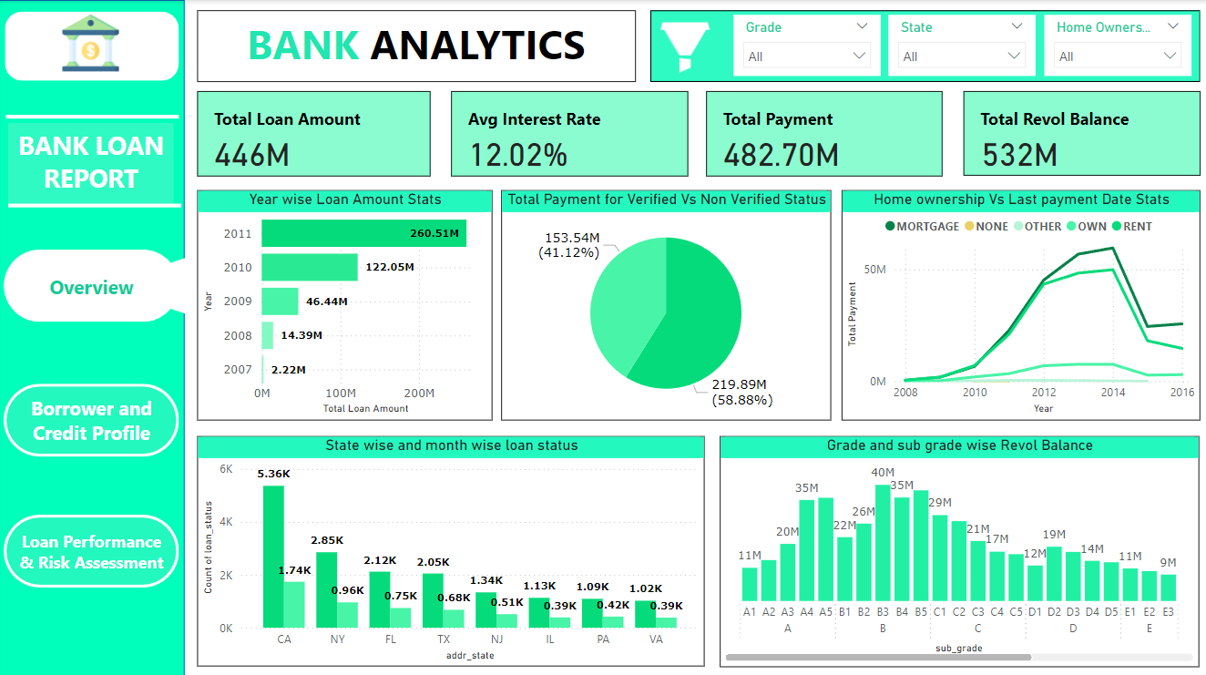
POWER BI DASHBOARD PAGE-1

Slide 18
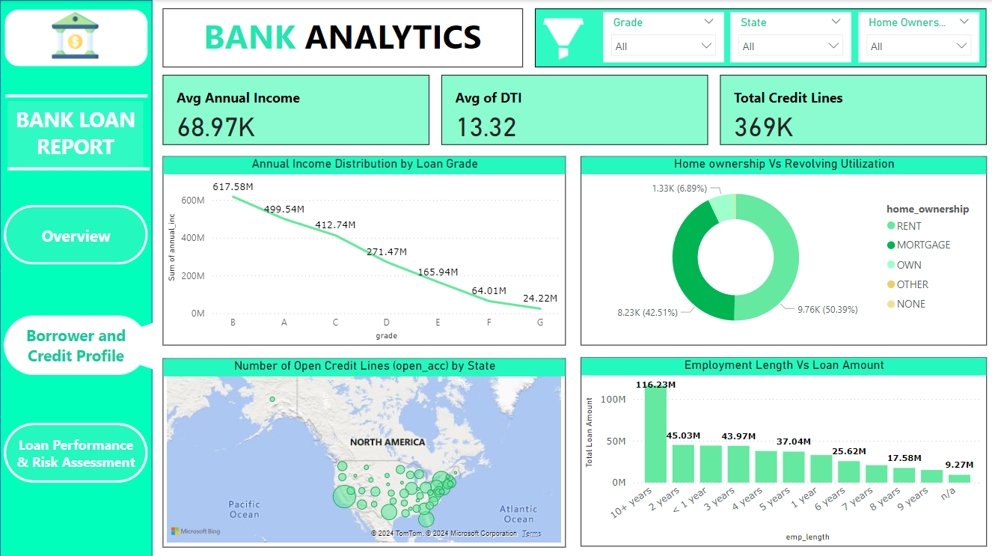
POWER BI DASHBOARD PAGE-2

Slide 19
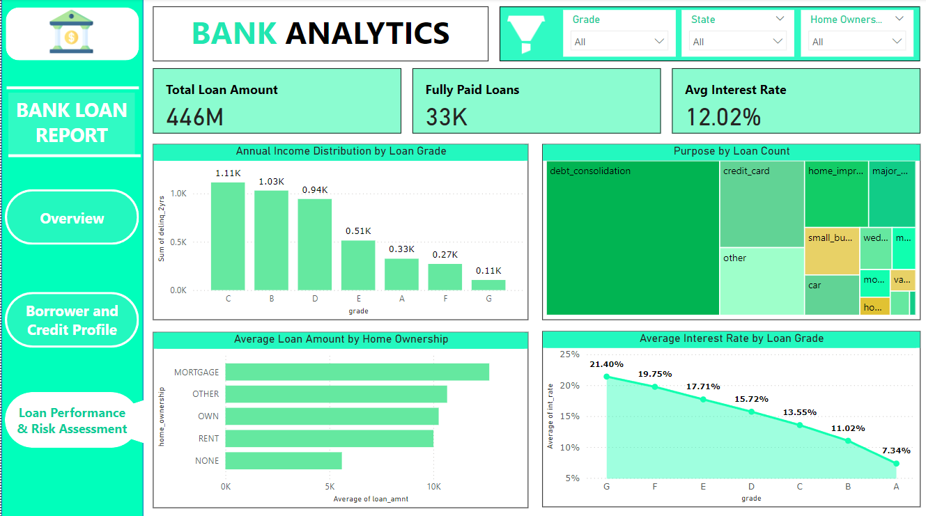
POWER BI DASHBOARD PAGE-3

Slide 20
Insights
We can clearly see that there is gradual increase in loan amount taken from one year to another year.
Revol_bal is more in grade B customers and least in grade G customers.
The data indicates a clear distinction in total payments between verified and non-verified status. Verified accounts, comprising 41.12% of the total, have contributed $153.54 million, while non-verified accounts, representing 58.88%, have contributed $219.89 million.
Fully Paid had the highest total Count of loan_status at 32,950, followed by Charged Off at 5627 and Current at 1140.

Slide 21
Recommendations
Verified borrowers contribute 58.88% of total payments. Encouraging verification will help reduce risk and improve loan recovery rates.
Grade B has the highest revolving balances. Targeting this segment with tailored loan products and better credit terms could further increase profitability.
Mortgage holders show the highest repayment consistency. Strengthen lending strategies for homeowners to maintain this reliable repayment flow.
The decline in loan payments after 2014 among mortgage holders and other ownership types requires further investigation to adjust the bank’s risk mitigation strategies.

Slide 22
Conclusion
The analysis reveals strong loan growth in key states like California and New York, with verified borrowers and Grade B clients offering the best repayment potential.
Mortgage holders remain the most reliable segment, though a post-2014 payment decline needs attention.
Focusing on high-performing regions and verified borrowers will enhance profitability while mitigating risks.
Engaging in this project has been a valuable opportunity for skill development and refinement. We have strengthened our proficiency in Excel, Tableau, Power BI, SQL and Data Analysis.

Slide 23
THANK YOU

